Slide 1
Data Engineering and Analytics
Test Case
By :
Data Engineering and Analytics Team
Jul-19

Slide 2
Instruction
Welcome!
Thanks and congrats you are one step ahead to join us. In this technical test you will find 3 section
SQL
Technical Programming
Revert back the result to us and dont be shy to ask question through email if you have any.
Have a nice day!

Slide 3
SQL

Slide 4
SQL Case
Hi,
We are in need someone to do some query to our data warehouse and format/structure it into something that can be used by our analyst or data science team either in their dashboard or data model feature. For this purpose you will be given a sample dataset with their structure and our user’s problem/requirement.
Dataset:
You will be working with this sample dataset and their definition given in the next slides. Take your time to understand the data structure so you will be able to solve the upcoming problem.
Problem:
These will be the requirement we need you to solve. There are 5 problem you will need to work on ordered by their relative difficulty. Good luck.
**Expected result : <sql-script-file>.sql

Slide 5
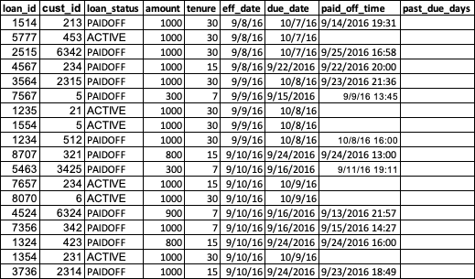
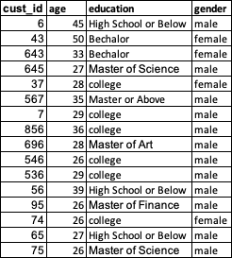
Dataset
Table: transaction
Biz Glossary/Data Definition
loan_status (string): whether loan already paid or not contain ‘PAIDOFF’ or ‘ACTIVE’.
amount (integer): total amount of that transaction
tenure (integer): how long the installment is 7, 15, 30, 60, etc. in days.
eff_date (date): date when the transaction happen and the installment start counting
due_date (date): when the transaction need to be paid
paid_off_time (timestamp): when the customer actually paid the transaction
age (integer): customer’s age
education (string): customer’s last education level
gender (string): customer’s gender
days_past_due (integer): how many days after due_date customer havent make payments.
Table: customer

Slide 6
Problem
Problem:
Construct query script to solve below problem using previous page dataset, preferably in sql code compatible with PostgreSQL standards:
Show total amount of transaction made by/grouped by customer’s age and gender.
We have a typo in education, find it and fix it within your query. Also there are still many variance of Master degrees that need to be combined into 1 (called ‘Master Degree’). Then after all that show total unique customer by their education level that has transaction with us.
**Expected result : <sql-script-file>.sql
***Also please state any assumption in comment if you have any,

Slide 7

Problem
Problem:
Construct query script to solve below problem using previous page dataset, preferably in sql code compatible with PostgreSQL standards:
For each customer and their tenure selection, we need their first transaction eff_date, due_date, and paid_off_time if they already paid. Then afterwards for each first transaction of that hasn’t paid we need to calculate their days_past_due compared to today. Terms and tenure is same.
**Expected result : <sql-script-file>.sql
***Also please state any assumption in comment if you have any,

Slide 8
Problem
Problem:
Construct query script to solve below problem using previous page dataset, preferably in sql code compatible with PostgreSQL standards:
Need a summarized customer table consist of below format. For every customer their summary of total amount, when is their first and last transaction, due date, and not forget their favorite tenure product (either 7, 15, 30, etc.). Terms and tenure is same.
**Expected result : <sql-script-file>.sql
***Also please state any assumption in comment if you have any,

Slide 9

Problem
Problem:
Construct query script to solve below problem using previous page dataset, preferably in sql code compatible with PostgreSQL standards:
We need a summary table of age profiling as below with age bucket and their top and bottom amount in transposed format. And within their age group top-3 (biggest amount) and bottom-3 (smallest amount) along with their customer_id all in a transposed format as below.
**Expected result : <sql-script-file>.sql
***Also please state any assumption in comment if you have any,

Slide 10
Technical Programming

Slide 11
Data Collection Case
Case study:
Our product and data science team are in need of ecommerce products data available currently in the market. As a data engineer we require you to build a prototype of a crawler with specification of :
Crawl data from one of Indonesia’s Ecommerce site product page (your choice, free).
Use a proper Python 3 script
Mandatory information result of Product Name, Category, and Price
Result would be in file format of : csv and json
Use your own creativity to determine another extra mile that benefit our business users such as extra information field and short explanation why do you think this is important in the long run. Also don’t forget to help your other team mate, please make your code/script is as neat as possible and gave a lot of comment/mark about what your code do.
**Expected result : <python-script-file>.py, <result-file>.csv, and <result-file>.json

Slide 12
GGWP

